Slide 1
Neural Network?
Sounds Complicated.
RX 319
Introduction to Healthcare Analytics
Notes:
Hello! In this video I’ll introduce a type of supervised learning called neural networks.

Slide 2
Learning Objectives
Explain what a neural network does.
List the elements of a neural network.
Describe “deep learning.”
Notes:
I’m going to give you the basics of what a neural network does and what’s in a neural network, and we’ll discuss a special type of neural network that does what’s called “deep learning”.

Slide 3
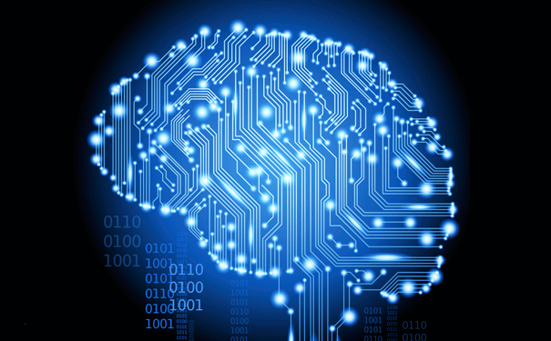
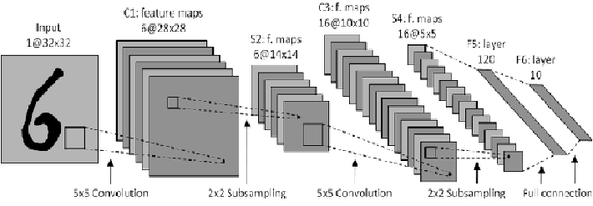
Neural network? Sounds complicated.
Notes:
Whenever you hear about neural networks in the media, they always make it sound like the most complicated thing in the world, **** or maybe even magical. While they are complicated in some ways, if you focus on the basics of what they do, they’re also simple in some ways.

Slide 4

Neural networks
Train model using past data
$${math}_{1}=i_{1}w_{1}+i_{2}w_{3}$$
i₁
math₁
w₁
w₅
w₂
o₁
w₃
i₂
math₂
w₆
w₄
Input Layer
Hidden Layer
Output Layer
(It’s just math)
Notes:
This is an example of a very simple neural network. They have circles that we call nodes, and arrows that we call edges. The nodes are grouped into layers going from left to right, and each has its own name.
The first layer is called the input layer. This is all of the data that we’re going to use to try to make a prediction. If we’re using a clinical data set to predict whether patients will get a disease or not, the clinical data will go into this input layer.
The output layer is what we’re trying to predict. So we’ll put the disease status of each patient in our data set in the output layer, so we know who got the disease and who didn’t.
Finally, we have something that’s mysteriously called the Hidden Layer, *** which is just math. *** Basically, we multiply the numbers in each circle by whatever w, or weight, and then send them into the next circle, *** where we might just add them up, for example we can just take i1 times w1 plus i2 times w3, as you can see from the arrows going in. Or we might use some other equation, but they’re generally not super complicated.
Similar to other supervised learning methods, we’re going to try to figure out “w” numbers that help us predict the output from the inputs. So we’ll try to figure out w’s to predict disease based on the clinical characteristics. Then when we get a new patient and we don’t know their disease risk, we’ll be able to use this model to predict it based on their characteristics. So if they have high risk, we can make recommendations to hopefully lower the risk.

Slide 5
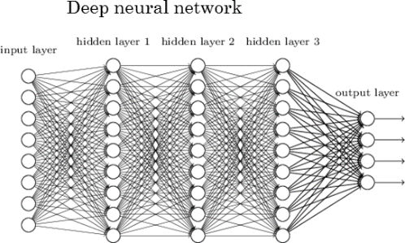
“Deep” Neural Networks
Notes:
A deep neural network is the same idea, it just has extra hidden layers. This one has three hidden layers, but they’re still just a bunch of math equations. These are called deep neural networks, and this is also known as “deep learning”. Sometimes this does a better job at making predictions than simpler supervised learning methods, but they take a lot more computer power. They also can be harder to interpret than other methods: sometimes it’s hard to tell why the computer made the prediction it did, and when that happens, you have to be really careful about the data you’re giving to the model and the predictions coming out. It’s possible for a computer to pick up on hidden biases that we may not have been thinking about, and these can be used to propagate inequities when used on people. But if used properly, there are lots of possible benefits in healthcare.

Slide 6
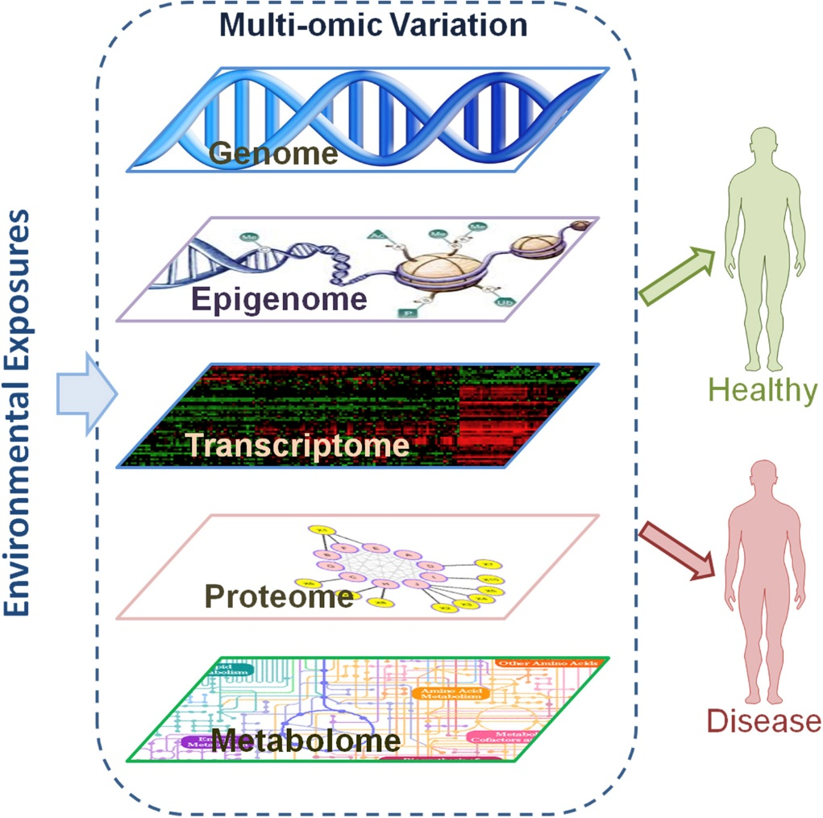
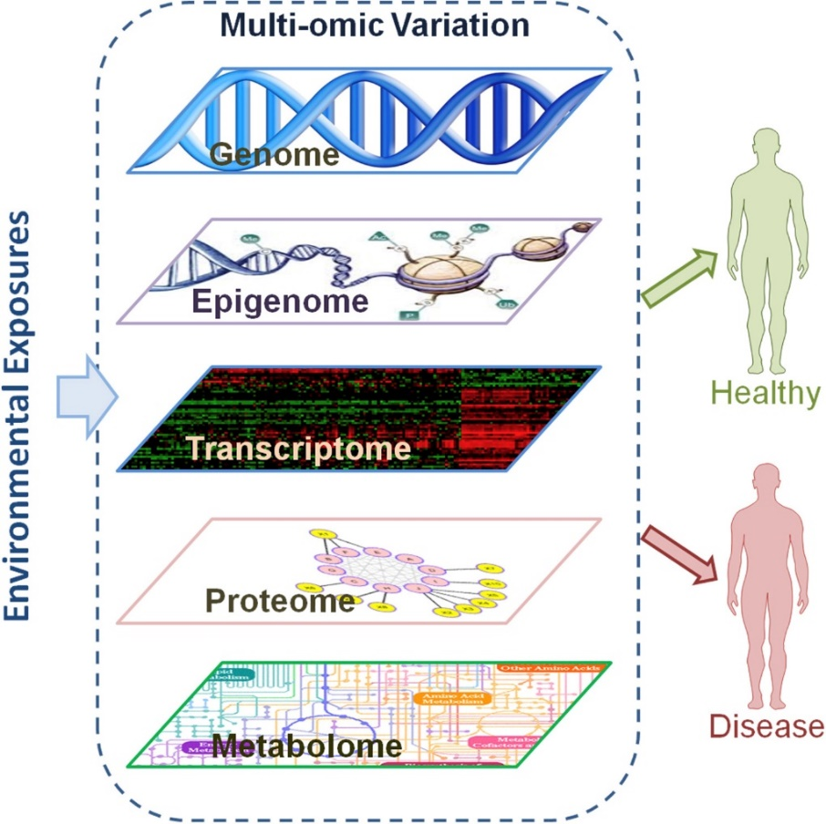
Neural Networks for Disease Prediction
Notes:
In addition to using clinical data for disease prediction, neural networks are being developed to use genomic and other complicated data sets to predict disease risk, or to predict which drug might be the best for a certain patient.

Slide 7
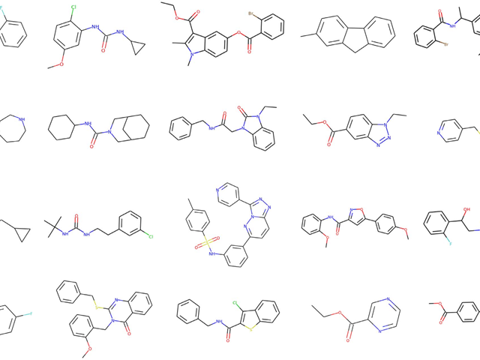


Neural Networks for Drug Discovery
Good drug
Bad drug
Notes:
Other neural networks are being used to discover new drugs. These models use molecular structure data and other chemical data to predict which molecules might be useful new drugs, based on tons of data from experiments that were conducted in the past. One neat thing about this is that they don’t even need to be molecules that have been synthesized before, they could be things that were just created in the computer. But if the computer says that this molecule might be a good drug for some disease that needs a new treatment, then we could go synthesize it in a lab and then do experiments with it to see if it really works.

Slide 8
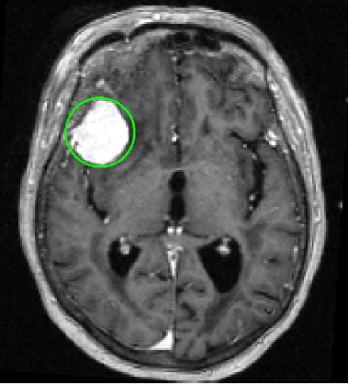
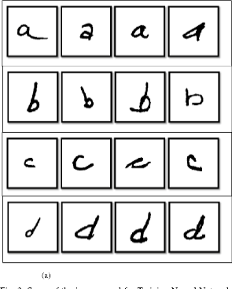
Neural Networks for Images
Turn each pixel into a 1 or 0 (black or gray)
Notes:
Finally, neural networks are becoming widely used for image data. *** Basically we’ll start by turning the image into a bunch of numbers, and then we can run neural networks similar to before.
A few examples of neural networks for images are handwriting recognition software, which can be used to help read handwritten prescriptions or other handwritten notes. *** These models are also being developed to detect tumors based on patient imaging data, and in some cases they can even predict whether a tumor is benign or malignant.

